Slide 1
AI Software Development
Tips, tricks, and pitfalls for writing AI (mostly EC) code in 2023 By Deacon Seals

Slide 2
Disclaimer
Software development is an inherently subjective topic filled with lots of opinions
There is no “one size fits all” approach to writing software as any supposedly optimal approach often varies by expertise, resources, and domain
Goals:
Make you aware of tools
Highlighting when to use different tools

Slide 3
Abridged Qualifications
Undergrad (2013-2018)
Missouri University of Science and Technology
Electrical Engineering, Computer Engineering, and Computer Science
2 years as a design lead on a student design team
Year 1 – Lead of Electronics
One-person team under higher-ranking project lead
Poorly planned project that failed
Learned a lot about how not to plan a project
Year 2 – Lead of Innovation
Recruited students from my majors
Leveraged existing experiences to design a project I could solo if necessary
Won 2nd place innovation reward at international engineering competition
Rapid prototyping internship between design lead positions
Led 2 semester senior design team of 2 other electrical engineers
Machine that creates artificial muscles from fishing line

Slide 4
Abridged Qualifications
Teaching Assistant
Started as undergrad in 2018 for AI course
Added EC in 2018 as grad student
Became Lead TA in 2019
Assignment Curriculum Designer in 2021
Mentor TA starting in 2022
Research
Started on poorly-planned solo project in 2018
Joined CEADS-LIN in 2019
Collaboration with Los Alamos National Lab
Became Technical Project Lead in 2020
More than a dozen members at peak
Served as a mentor or advisor on at least a dozen other projects
Senior capstones, Master’s theses, research projects, etc.

Slide 5
Some observations
Engineers and software developers love to make everything from scratch
Drive for ambitious goals/exercises
Unwilling to learn new tools
I’m not a graceful learner without an immediate knack
People will go through great lengths to avoid paying attention or critical thought
Don’t Make Me Think: A Common Sense Approach to Web Usability - Steve Krug
Less energy to personify inanimate objects
Hope for unsolvable or niche problems (e.g., novel compiler bugs)
Hail Mary solutions
Delete and rewrite code
Ask ChatGPT

Slide 6
Some observations
Lots of good, useful characteristics can strangle a project in excess
Tenacity -> stubbornness
Flexibility -> flighty
Optimism -> audaciousness
Ambitiousness -> unrealistic
Creativity -> scope creep
Projects need accountability
Project failure can be the most valuable experience (in moderation and with added effort effort)

Slide 7
Common pitfalls
Blind/dogmatic use of a programming language, tool, or technique
When you have a hammer, everything looks like a nail
Failing to prioritize project success
Building everything from scratch and/or reinventing the wheel
Sacrificing progress for the sake of a tangent
Adding features (scope creep)
Using a project to “learn a new language” (or similar)
Never clearly establishing project goals or scope
Failure to adapt to changing requirements or needs
The sunk cost fallacy
Reluctance to abandon something because of heavy investment

Slide 8
Overview
Projects
Development
Tools
Starting a project
Executing a project
Tips for research
Picking a programming language
When to make a new tool
Lots of slides about Python development
Recommendations to build on top of

Slide 9
Projects

Slide 10
Starting a Project
Is the primary goal learning a skill or completing a task?
Beware inadvertently swapping these during the project
Differentiate between these projects
Establish dedicated learning projects if necessary
Define clear project goals and scope
Establish criteria for project success
E.g., the existence of a specific set of features, data on the performance of a new mutation operator, etc.
Don’t make everything from scratch!
Determine milestones required to satisfy success criteria and meet project goals
Pick the right tools for the job (more on this later)

Slide 11
Executing a Project
Identify a minimum viable product (MVP)
What components are hard requirements for project success?
What components are optional?
Can you complete the MVP and make optional components stretch goals?
Be pragmatic about project progress when considering tangents
Is a new feature/subtask necessary for project success?
Will a new feature/subtask significantly improve the success of the project?
Be aware of timelines and deadlines (and beware scope creep)
Be prepared for failure and changing needs/requirements
Fail fast!
Determine failure criteria for rapid iteration

Slide 12
Tips for Research
Build off existing work
Much easier to determine originality of ideas
Good way to get citations
Do literature review early
Determining work originality after the fact is nerve-racking
Allows you to identify problems your work could address
Think like a scientist!
Define clear, measurable goals from the onset
Including success and failure criteria
Failure as a finding is a valuable project characteristic

Slide 13
Development

Slide 14
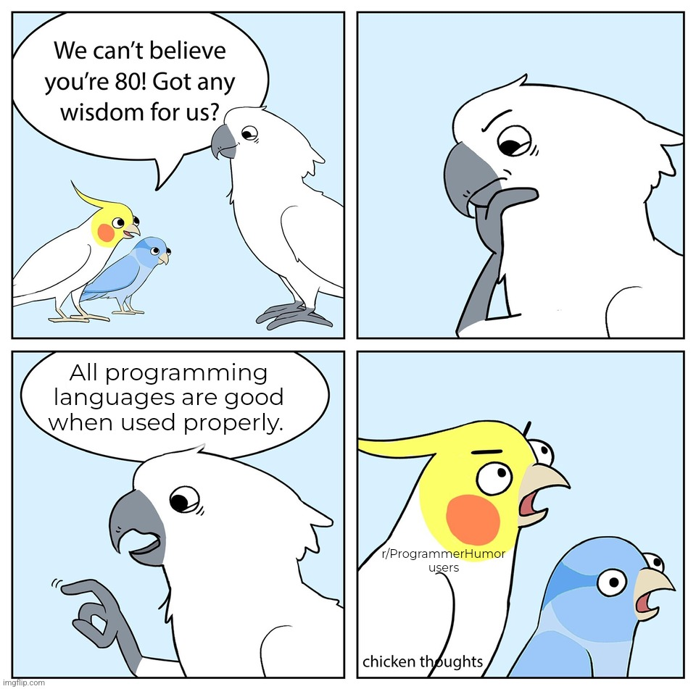
https://www.reddit.com/r/ProgrammerHumor/comments/wy7uxi/even_html/

Slide 15
Picking Programming Languages
View programming languages as a tool
Use the right tool for the job
Let existing resources and tools guide you
Are there existing implementations of important components of your target application?
E.g., you need to use a complex physics simulation that is only implemented in C++
What languages are these implementations in?
Of the programming languages with rich library support, which one best suits your needs?
Pick languages at the right level of abstraction for your project
Don’t ignore development time or only focus on compute time!
Human development time is often expensive
Let computers work for you
Consider combinations of programming languages
Consider high-level acceleration tools (e.g., GPU acceleration in Python)
My advice: only use low-level languages if you have a specific reason

Slide 16
When to Use a Low-Level Language
Required tools are implemented without a high-level interface
A complex physics simulation that only provides an interface in C
Your application is prohibitively computationally expensive, and that cost can’t be alleviated by higher-level parallelism or acceleration
Consider only implementing required portions in a low-level language
Your project has the specific goal of learning a low-level language

Slide 17
When to make a new tool
Scenario 1: there no existing tools that satisfy your project’s required capabilities
I.e., the thing you need completely does not exist
This does not include performance requirements
Scenario 2: tools exist that satisfy your project’s required capabilities, but they suck “enough”
Performance of existing tools is so poor that creating a replacement would be a meaningful contribution to your field
Your use case of existing tools is so ill-suited to their intended use case that creating an alternative or wrapper would be a meaningful contribution to your field
You have attempted to use existing tools and found their documentation so incomplete that using their code is impractical and creating an alternative or wrapper would be a meaningful contribution to your field
Litmus test: would a new tool be a meaningful contribution to your field?
Are there specific improvements you could provide or use cases you could expand support to?

Slide 18
Lots of Slides about Python
Python became incredibly popular in the AI community
Replaced LISP, Java, C++, and other lower-level languages
Library support is very good
Mature, well-optimized libraries developed and funded by Google, Meta (Facebook), and others
Frequently use faster, low-level languages under the hood (more on this later)
Python has a high level of abstraction
Great for rapid prototyping
First-party libraries like multiprocessing and random are performant and feature rich
Flexibility enables lots of footguns (more on this later)

Slide 19
Required Development time by Programming language
Pure Python*
Python with low-level components
Pure low-level language development

Slide 20
Caveats of Python
Prone to abusive programming practices
Using dictionaries instead of classes
Inconsistent use of variable names and data types
High-level abstractions can obscure computational cost
Example: if individual in population: # do something
O(n) if population is a list
O(1) if population is a set or dictionary

Slide 21
Caveats of Python
Python doesn’t support sharing Python variables in memory between processes
Must use shared ctype variables or a manager process that host variables
Python has quirks that are unintuitive when compared to other languages
Implicit pass-by-reference and pass-by-value
Multithreading vs multiprocessing

Slide 22
“Python is slow”
Optimized compiled code is typically faster than equivalent interpreted code (Python)
Algorithmic time complexity still dominates language-based performance differences in most cases
Development time is often far more expensive/valuable than compute time
The primary exceptions to this are caused my severe computation resource constraints (e.g., embedded devices or very large amounts of data)

Slide 23
Making Python “Fast enough”
Using a C/C++ core and/or accelerators
PyTorch, Tensorflow, NumPy, JAX, scikit-learn, iGraph, and many more
A very common trend for domains known for high computation cost
Just-in-time compilation
Compile portions of Python code at runtime (e.g., PyPy, Numba, and JAX)
Potential performance improvements vary by workload
Use a profiler (please)
python –m cProfile -s tottime myPythonProgram.py

Slide 24
Tips for Writing better Python
Know when to use different data structures
List vs set vs heap
Applicable to all programming languages
Pay attention to data type and what’s happening “under the hood”
Membership check on list vs set
Use multiprocessing pools and multiprocessing.pool.starmap_async() to easily parallelize function calls
Know when to use multiprocessing (concurrent execution) vs multithreading (sequential execution) too

Slide 25
Tips for Writing better Python
List comprehension can be faster than a for loop
Be careful to maintain legibility though
Tutorial: https://realpython.com/list-comprehension-python/
Generators can improve memory utilization and compute time
Tutorial: https://realpython.com/introduction-to-python-generators/

Slide 26
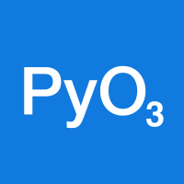
What About using Python with Other Languages?
Cython
PyO3
C extensions for Python
Not to be confused with CPython (the default Python interpreter written in C)
Generates C/C++ code and Python wrapper code
C functions can be called from pure Python wrapper functions
Rust bindings for Python
Creates native Python modules from compiled Rust
Interoperable with PyPy just-in-time compiler
Allows Rust code to call Python as well

Slide 27
Tools

Slide 28
Notable Libraries
Jax
Tensorflow / Pytorch
Accelerated linear algebra for Python
Includes JIT compiler
Auto-differentiation and GPU/TPU support
Deep learning libraries for accelerated gradient-based optimization
Feature rich with some caveats
Gym
OpenSpiel
RL environments with a standardized interface
Brax (gym in JAX)
May have migrated
RL environment for games
C++ (typically) wrapped for Python use
Link

Slide 29
Notable Libraries
evosax
QDax
Evolution strategies in JAX
Accelerated neuroevolution library
Primarily focused on CMA-ES
Accelerated Quality-Diversity
QD neuroevolution library
DEAP
Stable Baselines3
Distributed Evolutionary Algorithms in Python
GP, GA, MOEA, CMA-ES
Reliable reference implementation of deep RL algorithms
Useful if applicable

Slide 30
Legacy Libraries
ECJ
PyTorch NEAT
Java-based Evolutionary Computation Research System
Useful if your application domain meshes with Java
Support for wide variety of NEAT algorithms
Uses a very old version of PyTorch

Slide 31
Related Uncovered Topics
Running a group project/leading a project
Effective use of Git
Good versioning practices
Automated testing
Good practices for project portability
Avoiding “it works on my machine”
Project licensing
Picking a topic of research

Slide 32
Closing Remarks
Be realistic and practical
Set project goals and stick to them
Fail fast
Use the right tools for the job
Learning new tools is valuable experience
Form good reasons for what you do and don’t like about existing tools
Your time is valuable
Let computers work for you
Stand on the shoulders of giants (and all that)

Slide 33
THANK YOU
Questions?

