Slide 1
Genetic Programming Tree Implementation for Pac-Man Controllers
Slides by Deacon Seals with minor edits by Braden Tisdale Modified from original slides by Josh Wilkerson

Slide 2
Assignment Series 2 Roadmap
Assignment 2a: Random Search Through Parse Tree Space
Assignment 2b: Full Genetic Programming
Assignment 2c: Competitive Co-Evolution
Ramped Half-And-Half
Grow method
Full method
Print trees as strings
Tree execution
Recombination
Mutation
Modified child_generation
Tweak your Pac-Man genotype to evolve Ghosts (with slightly different sensors)
Recall that recombination and mutation are exclusively separate methods for generating a child
Co-evolve populations for each controller type and perform competitive fitness evaluations

Slide 3
Simplified Pac-Man
Pac-Man starts in the top left cell
Ghosts start in the 3 remaining corners
Units can move up, down, left, and right
Pac-Man can also hold position, but ghosts can’t
All units move at the same time
Units can’t move off the edge
Ghosts may occupy the same cell as each other
If Pac-Man swaps locations with a ghost or occupies the same cell, the game ends
The game also ends if the timer expires or if all pills are consumed
Online Visualizer

Slide 4
The Setup
Problem Formulation
Current state $s$
Current state 𝑠
All valid actions $a∈A\left(s\right)$
All valid actions 𝑎∈𝐴(𝑠)
Known state transition $s\left(a\right)→s′$
Known state transition 𝑠(𝑎)→𝑠′
Find a function $V(s′)$ that assigns a value/score
Find a function 𝑉(𝑠′) that assigns a value/score
Locations of pills, players, fruit, and walls
Select the action that produces either the highest or lowest value
Experiment and find out which greedy policy performs better
We want to evolve this!
The agent is assessed based on the final score of the game

Slide 5
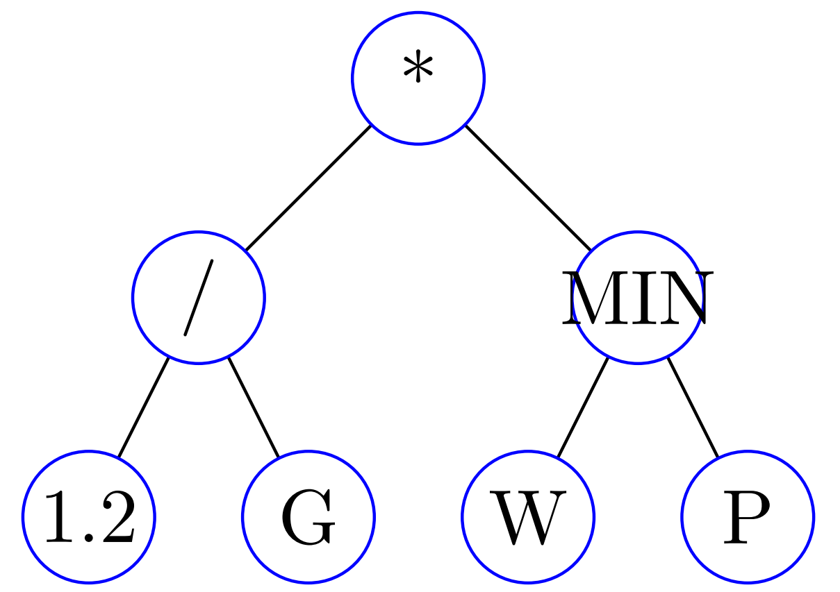
The Setup
The Scoring Function
Will be represented as a tree (hence the GP)
Depth first, in-order traversal
Operator nodes: + - * / MIN MAX (RAND)
Sensor input nodes:
Distance to nearest ghost - G
Distance to nearest pill - P
Distance to nearest fruit - F
Number of adjacent walls - W
Constant float value - #.#
Note: this isn’t a singular global value, but an ephemeral constant
See assignment material for official list of primitives!
Represents the function V(State) = (1.2 / G) * MIN(W, P)

Slide 6
The Scoring Tree: Nodes
Nodes in the tree
Represent atomic components of the scoring function
Nodes will need to have
An associated primitive
A place to store a value
A place to store children of the node
Node Primitive
Communicates what the node does
G, P, W, F, and #.# are leaf (sensor) nodes
+, -, *, /, etc. are internal (operator) nodes
Also called primitives

Slide 7
The Scoring Tree: Nodes
Node Value
This is only used if the node is a #.# (ephemeral constant) node
Will contain the value for numeric nodes
Node Children
This is only used if the node is an internal node
The children are the operands for this node
All of our internal nodes have two operands
Left and right children

Slide 8
Tree Initialization
Basic Tree Initialization Approach
Select a random primitive for the current node
Grow Initialization Method
Nodes above the depth limit are randomly assigned a primitive that can be operator or sensor
Full Initialization Method
Nodes above the depth limit are randomly assigned operator primitives
If node is an operator, recursively generate values for its children
If the node is a sensor, it has no children
Nodes at the depth limit are sensors
Generates sufficiently random trees with bounded depth
Nodes at the depth limit are sensors
Generates full trees with uniform depth

Slide 9
The Scoring Tree: Execution
Ok, so we have a scoring tree, how do we get a score from it?
Recursion!
Depth first, in order tree traversal pseudocode:
exec: takes in self and state s, returns a floating point score
if self is primitive `plus’:
return left_child.exec(s) + right_child.exec(s)
if self is primitive `minus’:
return left_child.exec(s) – right_child.exec(s)
...
if self is primitive `min’:
return minimum value of left_child.exec(s) and right_child.exec(s)
if self is primitive `ghostDist’:
return ghostDist(s)
if self is primitive `pillDist’:
return pillDist(s)
if self is primitive `number’:
return the value for self

Slide 10
A Note on Environment Interaction
State
Dictionary with named attributes
Evaluation
Game object will provide a list of states corresponding to valid actions
You must select the index of the action you would like to make
Walls – 2D list with [x][y] indexing
state[‘walls’][x][y] == True if wall exists else False
Pills – frozen set of coordinate tuples corresponding to pill locations
Fruit – coordinate tuple if fruit exists otherwise None
Players – dictionary of player-name : coordinate-tuple pairs
state[‘players’] = {'m': (0, 19), '0': (34, 0), '1’: (0, 0), '2': (34, 19)}

Slide 11
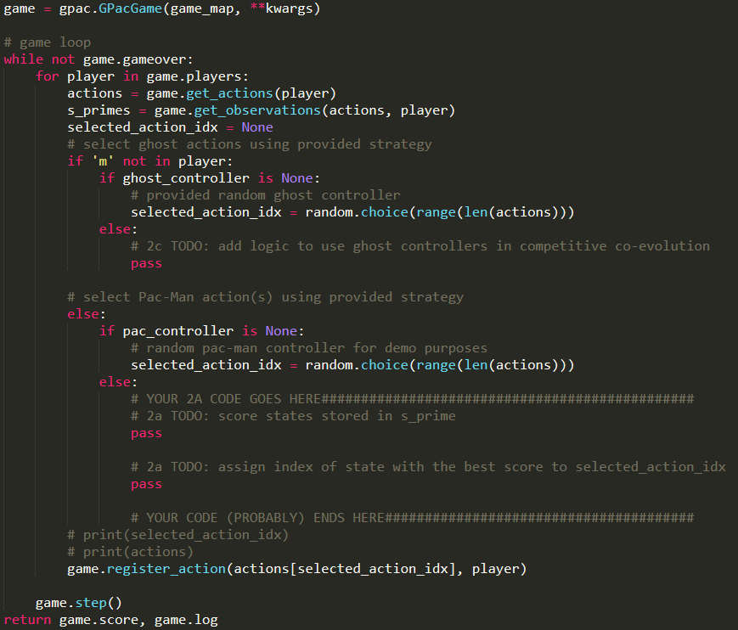
Provided Code

Slide 12
Other Implementation Details
Possible Random Sub-Tree Selection Method
Count how many nodes are in a tree
Generate a random value between 1 and that number
Walk through the tree, counting nodes until you reach the number selected
Possible Sub-Tree Crossover Method
Create copies of the parents
Randomly select a sub-tree from one parent copy
Replace a sub-tree in one copy with the sub-tree selected from the other

Slide 13
Other Implementation Details
Possible Sub-Tree Mutation Methods
Randomly change the node type
Changing from internal node to leaf node
Just trim off current children
Changing from leaf node to internal node
Have to generate random child nodes
Randomly select node type, generate operands (children) if necessary
Recursion may be useful here…
Randomly change node value
Only applicable to number nodes
Possible Parsimony Penalty Methods to Battle Tree Bloat
Penalize the number of nodes a tree has
Penalize the total height of a tree can
Always bound tree height in these assignments!

Slide 14
Advice For Assignment 2a
Implement Tree Generation First
Populate tree type and ignore execution at first
Sensor input primitives are a likely place for failure
Operator primitives are easier
Don’t forget about division by zero though
Don’t Dev Yourself Into A Corner
Print trees and use the tree checker tool
Test Execution With Single-Node Trees
Assignment series 2 is more open-ended
Keep recombination and mutation in mind
Dynamic Programming Can Make Agent Execution Much Faster
Two instances of the same sensor typically return the same value for a given state

Slide 15
Distance Calculations: Manhattan Distance
Distance as if one were walking city blocks (ignoring walls)
$D_{Manhattan}=\left|x_{0}−x_{1}\right|+\left|y_{0}−y_{1}\right|$
$D_{Manhattan}=\left|0−2\right|+\left|0−2\right|$
4
3
2
1
0
 | 0 | 1 | 2 | 3 | 4

