Slide 1
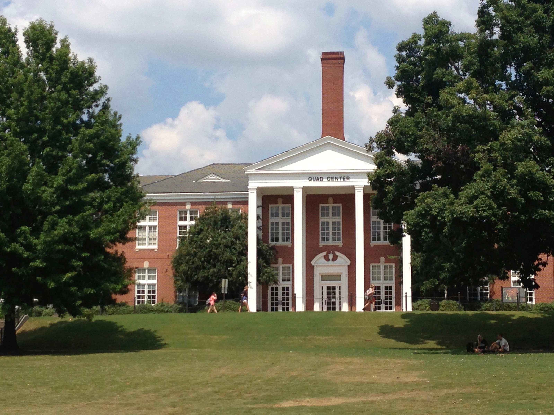
OMBUDSPERSON REPORT
UNIVERSITY SENATE
MARCH 21, 2017
C. Kevin Coonrod
Auburn University Ombudsperson
Quad Center, Suite 005
(334) 844-7170
ombuds@auburn.edu

Slide 2
mission statement
The Office of the Ombudsperson assists all members of the University navigate through difficult situations encountered at the University.
The Ombudsperson is responsible to the principles of independence, neutrality, confidentiality and informality, as well as the values and mission of Auburn University.
Every visitor to the Ombuds office is treated with respect, dignity and honor.

Slide 3
The Ombuds Does Not:
Adjudicate
Set Policy
Give Legal Advice
Serve as an Agent of Notice for the University
Participate in Grievances or Other Formal Processes
Provide Therapy
Advocate for any Party to a Conflict

Slide 4
milestones
Office Charter becomes University policy
Establishes the Ombudsperson’s services as independent, neutral, confidential and informal
Visitors cannot be retaliated against for visiting the Ombudsperson, nor can they be retaliated against for declining to see the Ombudsperson
Ombuds Coonrod becomes a Certified Organizational Ombudsman Practitioner (CO-OP®)

Slide 5
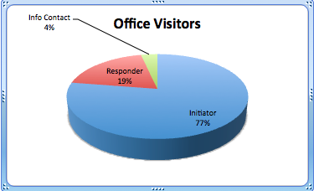
OMBUDSPERSON REPORT
2015/2016 ACADEMIC YEAR
Initiators - 156
Responders - 39
Info Contact - 7
Total: 202

Slide 6
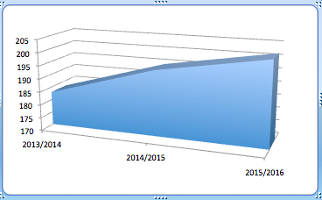
THREE YEAR RETROSPECTIVE
office visitors
2013/2014 - 183
2014/2015 - 195
2015/2016 - 202

Slide 7
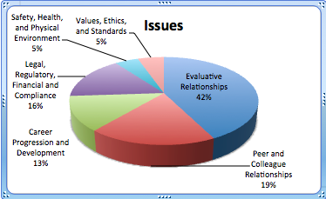
Issues
Evaluative Relationships - 80
Peer and Colleague - 35
Legal or Compliance - 30
Career Progression - 24
Values & Ethics - 10
Safety and Health - 9

Slide 8
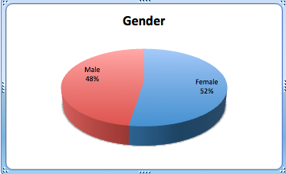
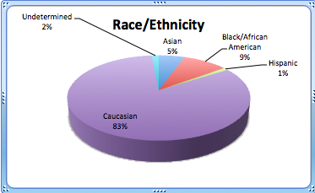
demographics
Caucasian - 167
Black/African American - 19
Asian - 11
Hispanic - 2
Undetermined - 3

Slide 9
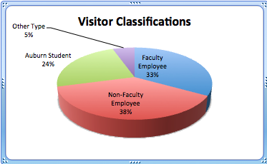
visitor classifications
Non-faculty - 76
Faculty - 67
Students - 48
Other - 11

Slide 10
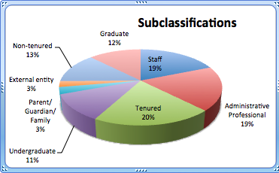
visitor subcategories
Tenured Faculty - 41
A & P - 38
Staff - 38
Non-tenured Faculty - 26
Graduate Students - 25
Undergraduate - 23
Parents - 6
External - 5

Slide 11
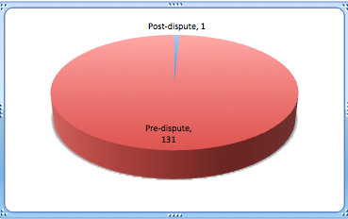
Pre and Post-Dispute
Pre-dispute - 131
Post-dispute - 1

Slide 12
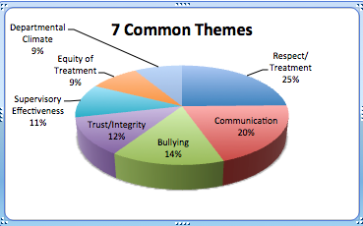
7 Common themes
Respect/Treatment - 83
Communication - 67
Bullying - 49
Trust/Integrity - 41
Supervisory Effectiveness - 37
Equity of Treatment - 30
Departmental Climate - 29

Slide 13
conflict resolution seminars
Teamwork: Building Results Collaboratively and Amicably
Working with High Conflict People
The Art and Productive Capacity of Active Listening
Identifying Underlying Interests: Tips from Nature, History and the Cinema
NBZ: The No-Bullying Zone (Auburn Camp Counselors)
Bullying and Mobbing in the Workplace and Academe

Slide 14
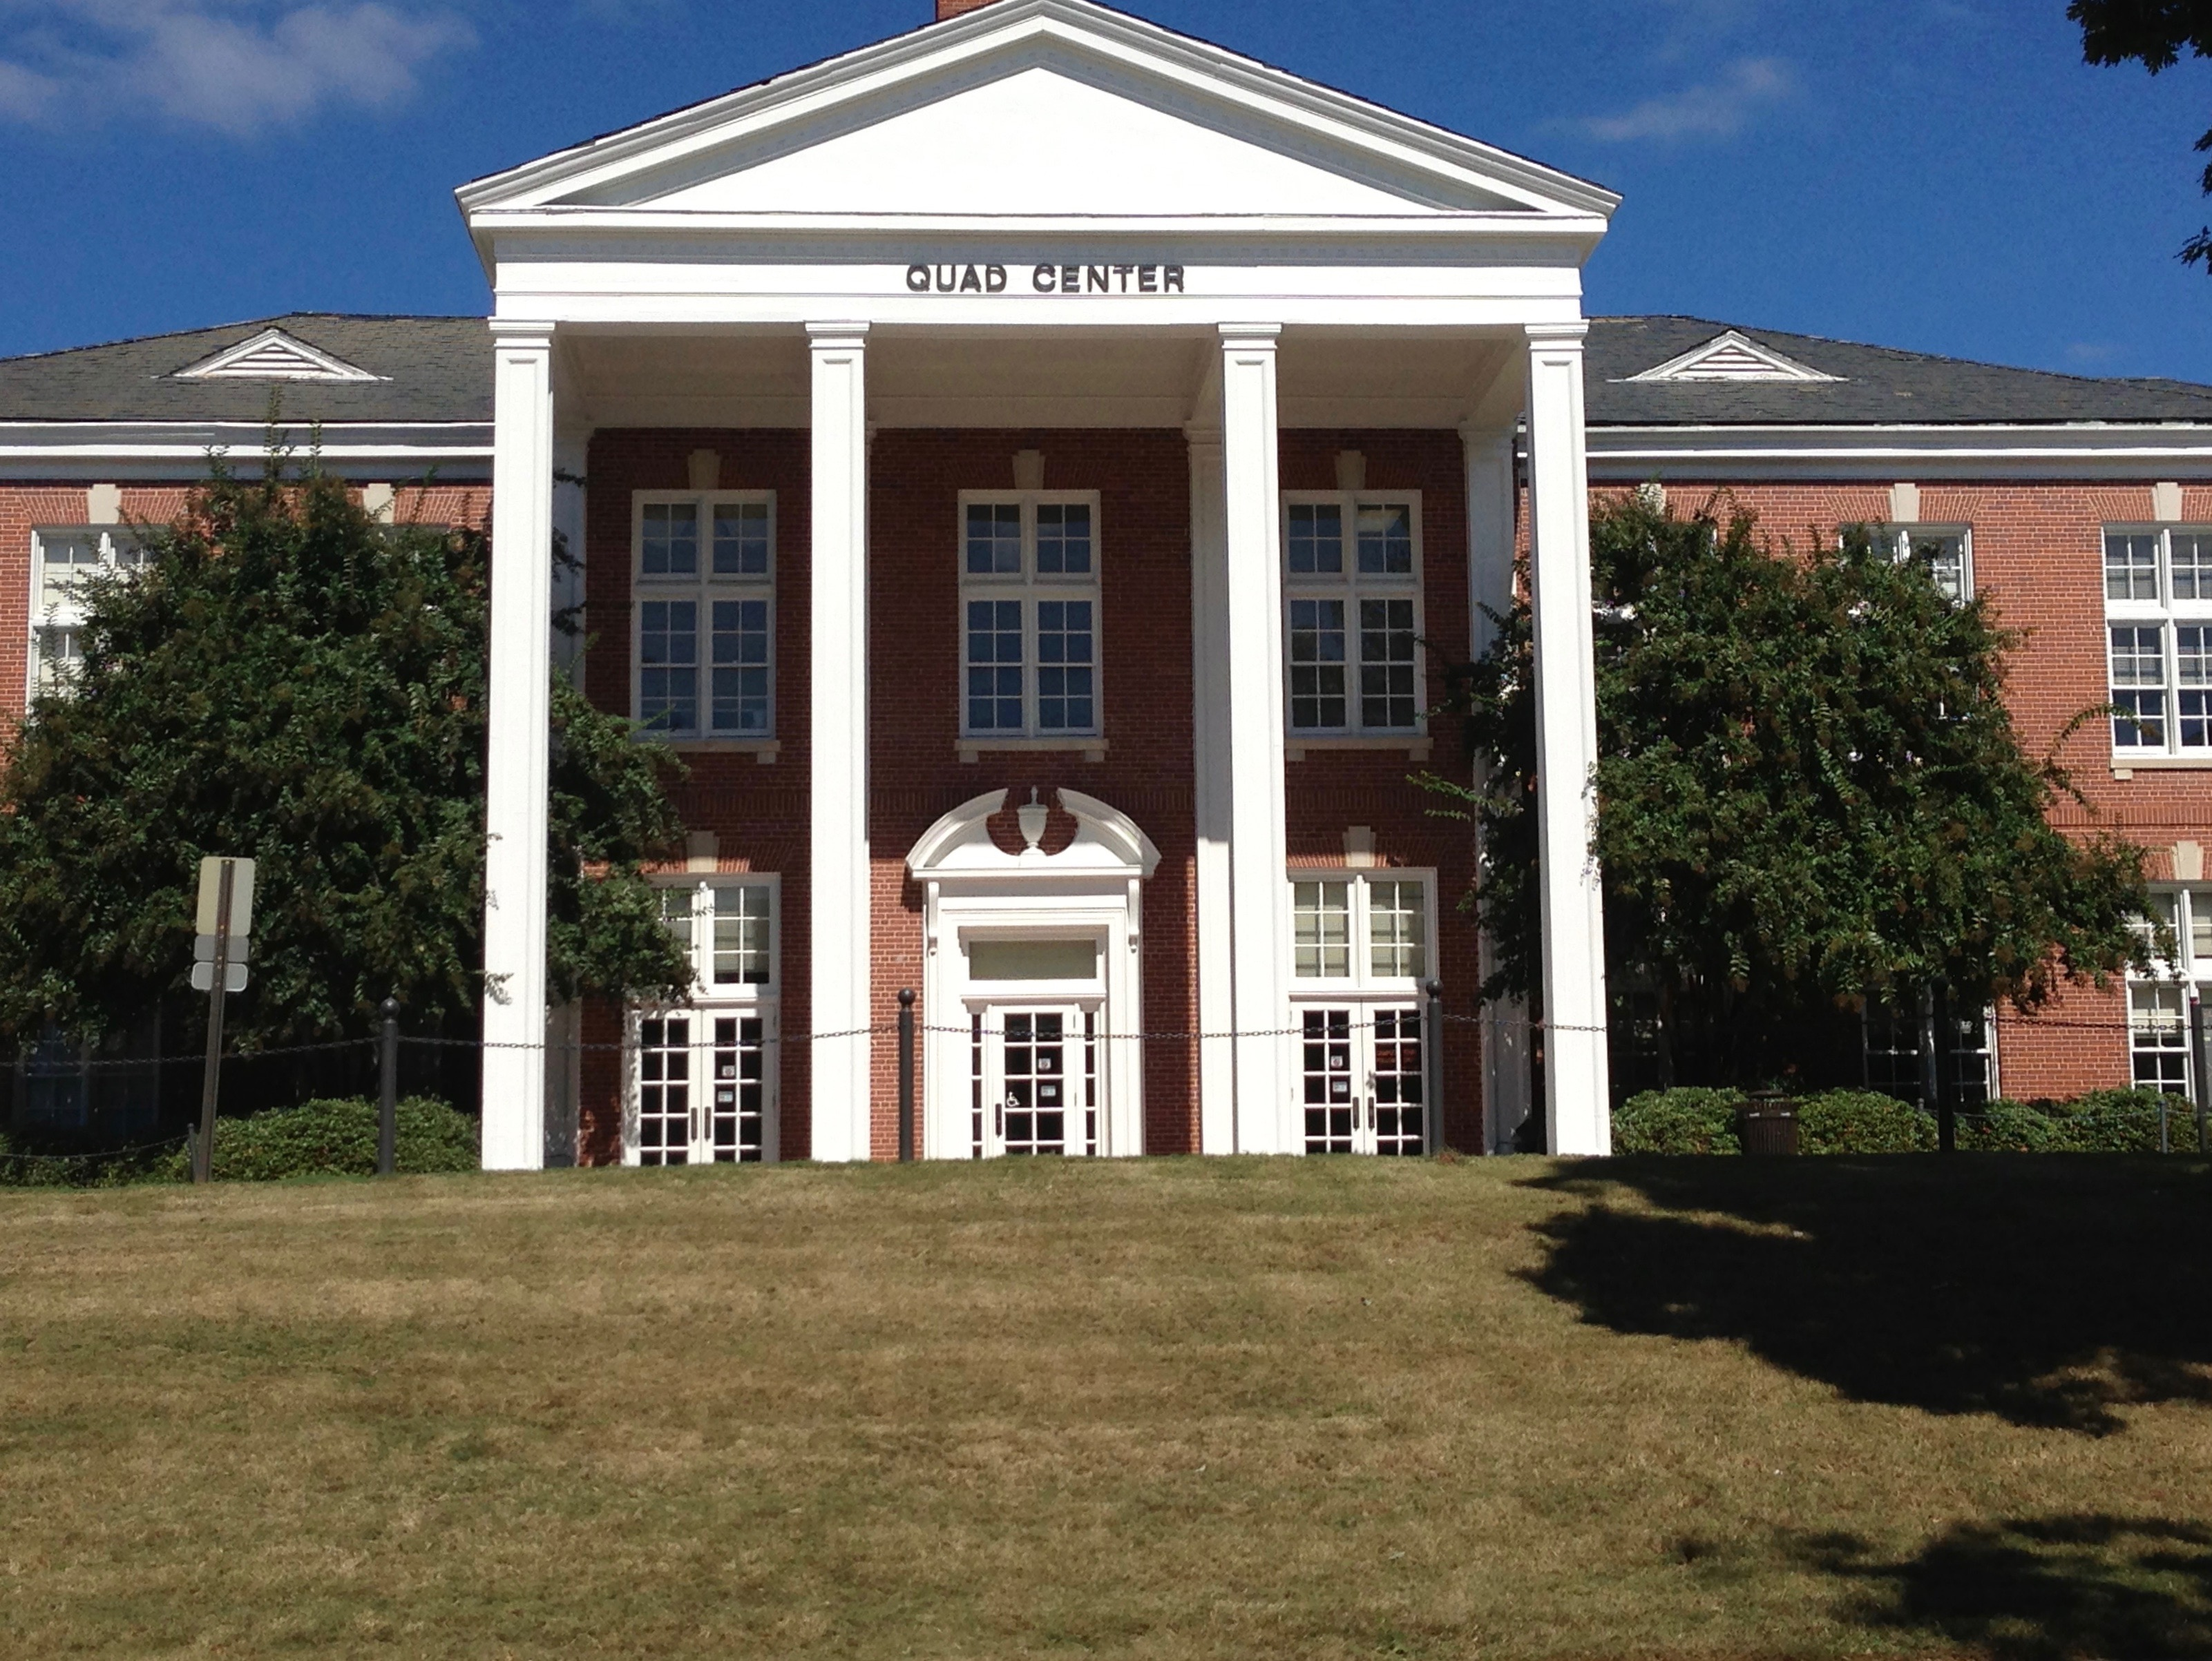
C. Kevin Coonrod
Auburn University Ombudsperson
Quad Center, Suite 005
(334) 844-7170
ombuds@auburn.edu

